Slide 2
Introduction
Real world driving is not able to …
Find critical scenarios for autonomous vehicles using search-based testing
A genetic algorithm will be used for the search task
It will use actions to control all NPCs in the simulation
Optimizes the cumulated emergency break duration of the ego vehicle
A BT is applied to the ego vehicle
Research Question 1
Is a genetic algorithm suitable for generating critical driving scenarios compared to random search?
Research Question 2
Can the performance of a genetic algorithm be improved by optimizing the control parameter using the Taguchi method?

Slide 3
Overview
Foundations
Implementation
Hyperparamter tuning
Evaluation

Slide 4
Traffic Manager
Behaviour Tree
Traffic Manger
Genetic Algorithm
World Information
World Information
Action Interface
EGO
NPC 1
NPC 2
…

Slide 5
Genetic Algorithm Implementation
Inspired by Natural Selection:
Modeled after the process of natural selection in biology.
Mimics the principles of evolution to find optimal solutions.
Population-Based Optimization:
Operates on a population of potential solutions.
Utilizes genetic operators like crossover and mutation for reproduction.
Iterative Improvement:
Solutions evolve over multiple generations.
Fitness function guides the selection of better solutions, leading to convergence.

Slide 6
Chromosome encoding - Time
0
1
2
3
4
5
6
7
8
9
10
11
12
13
14
15
16
17
18
19
Action NPC 1
Corresponds to timestep 1 (0.5 seconds)
Action NPC 2
…
Action NPC n
Notes:
Apollo Case Study

Slide 7
Chromosome encoding – Time and NPC
NPC 1
NPC 2
NPC 3
0
1
2
3
4
5
6
7
8
9
0
1
2
3
4
5
6
7
8
9
0
1
2
3
4
5
6
7
8
9
Corresponds to timestep 1 (0.5 seconds)
Action NPC 1

Slide 8
Gene Encoding
Encode as Integer
0 = NoAction
1 = JunctionSelection(straight)
2 = JunctionSelection(left)
3 = JunctionSelection(right)
4 = LaneChange(left, 3)
5 = LaneChange(right, 3)
6 = AbortLaneChange()
7 …
Encode as dictionary
{"type": "LaneChange", "direction": "left", "duration": 3}
{"type": "JunctionSelection", "junction_selection_angle": "straight"}
{"type": “AbortLaneChange"}
{"type": “ModifyTargetVelocity“, “percentage“: “133.4”}

Slide 9
Hyperparameter Tuning - Overview
Two steps:
Literature review
To get an overview and feel for what parameters are appropriate
Choose correct population size
Design of Experiment – Taguchi Method
…

Slide 10
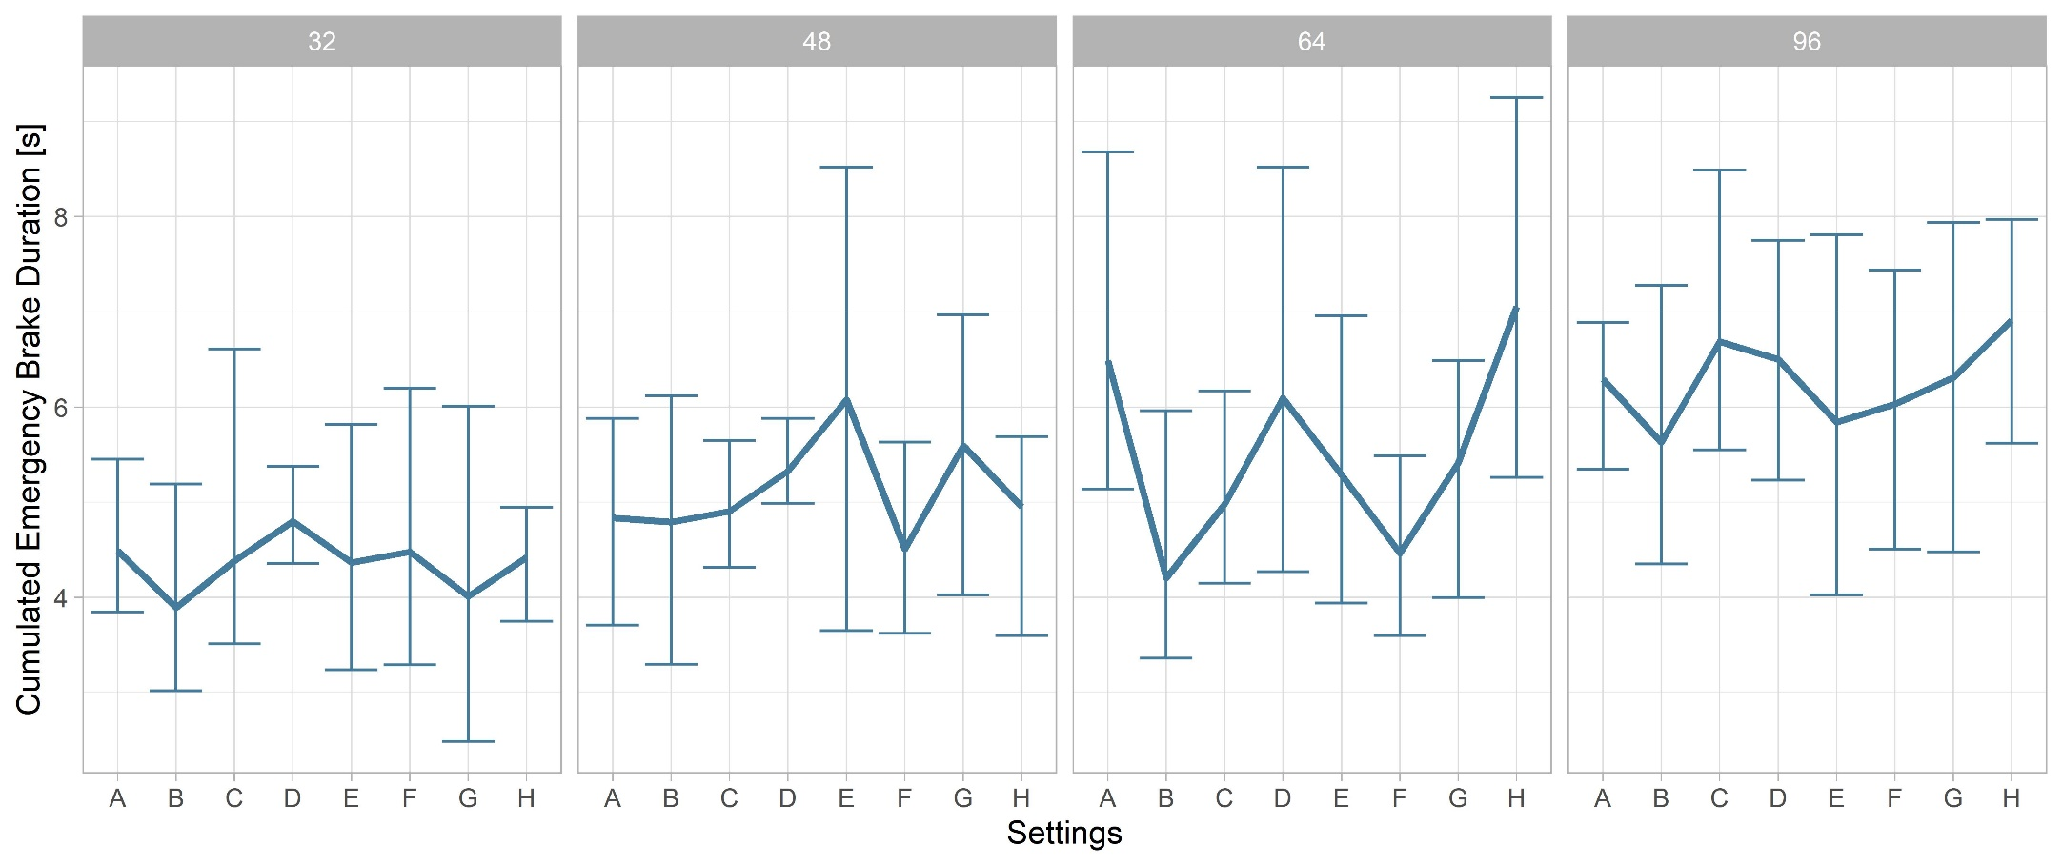
Hyperparameter Optimization: Literature Review

Slide 11
Design of Experiment – Taguchi Method
Introduction to DOE:
Systematic approach for process optimization.
Identifies factors impacting performance.
Introduction to Taguchi Method:
Developed by Genichi Taguchi for robust optimization.
Minimizes effects of variation.
Key Taguchi Concepts:
Signal-to-Noise Ratio, Orthogonal Arrays, Control & Noise Factors.
Advantages of Taguchi Method:
Robustness, Cost-Efficiency, Simplicity.

Slide 12
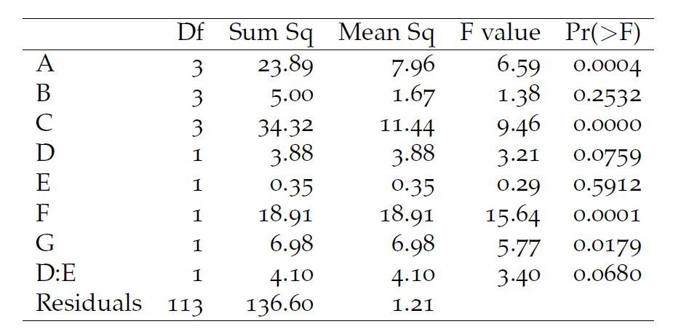
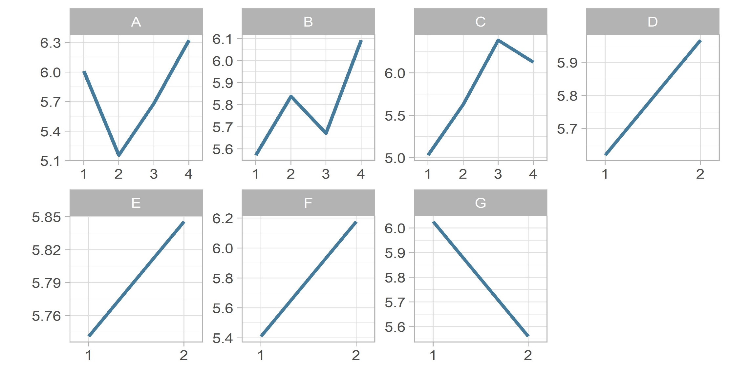
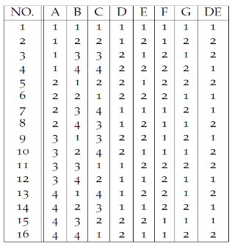
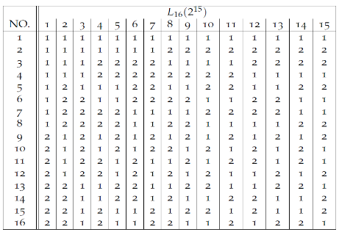
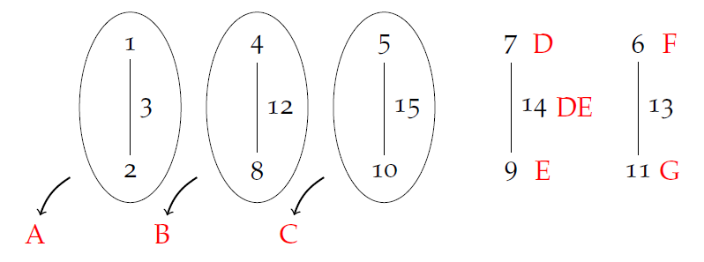
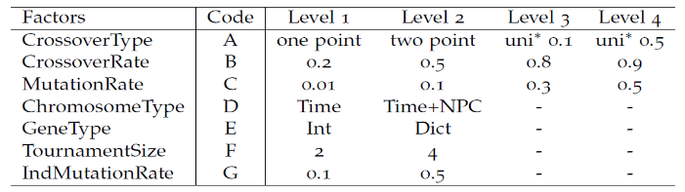
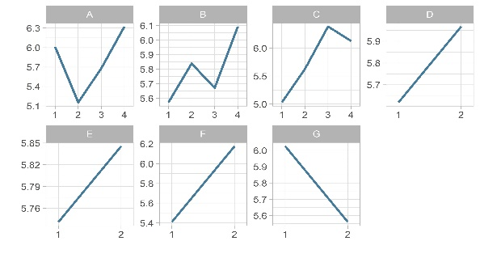
Taguchi Metho– Step by Step
Factor and Level Selection
L₁₆ orthogonal array
Linear Graph
Run experiment using modified L₁₆ array
ANOVA
Main and Interaction Effects

Slide 13
Evaluation
Comparison between:
Optimized Genetic Algorithm
Default Genetic Algorithm – uses best values from the literature review
Random Search
For each algorithm
4 different start scenarios
10 repetitions per start scenario
2976 simulations per repetition
Goals
Test if Optimized is than random (research question 1)
Test if optimized is better than default (research question 2)
Analyse if Optimized can generalize on different start scenarios where it has not been optimized on

Slide 14
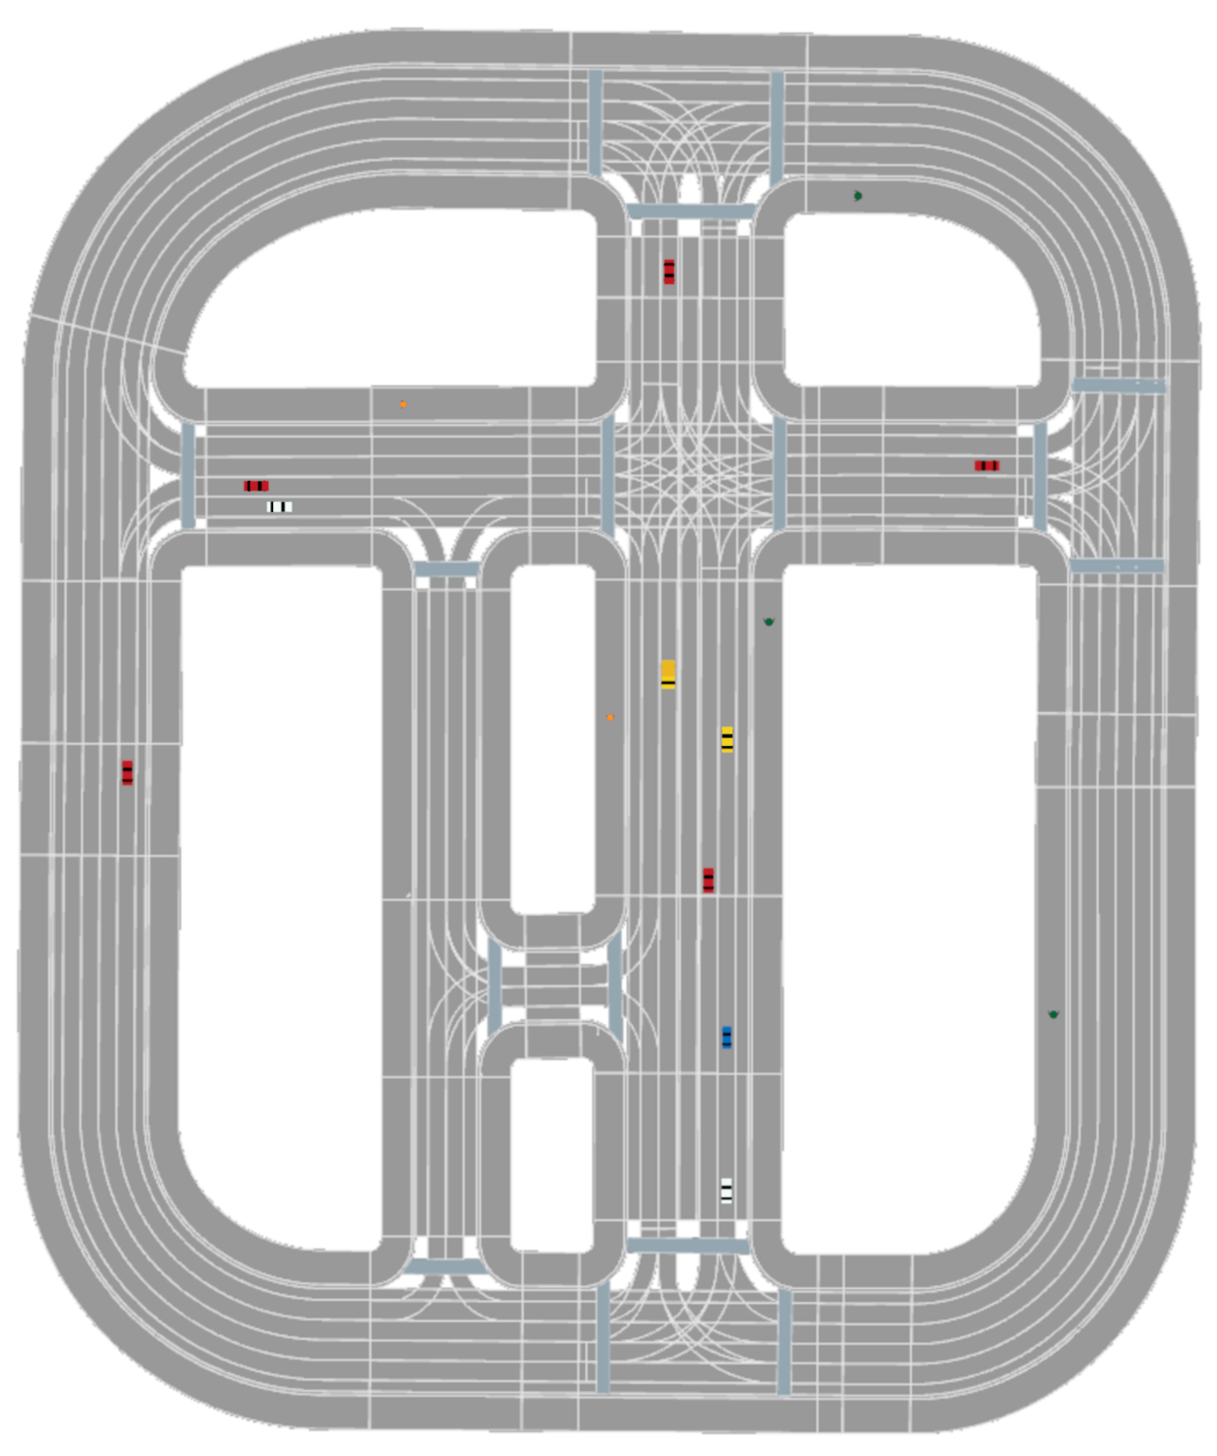
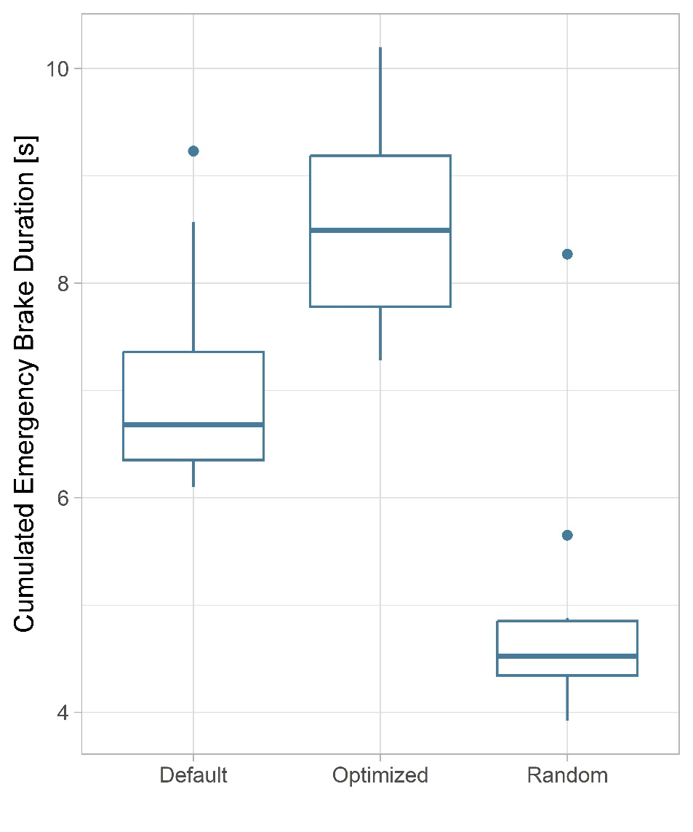
Evaluation: Start Scenario 1

Slide 15
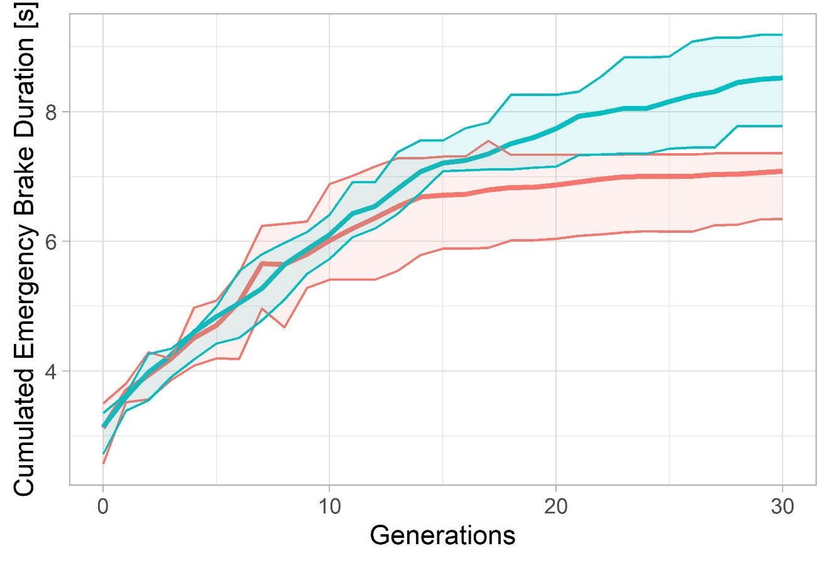
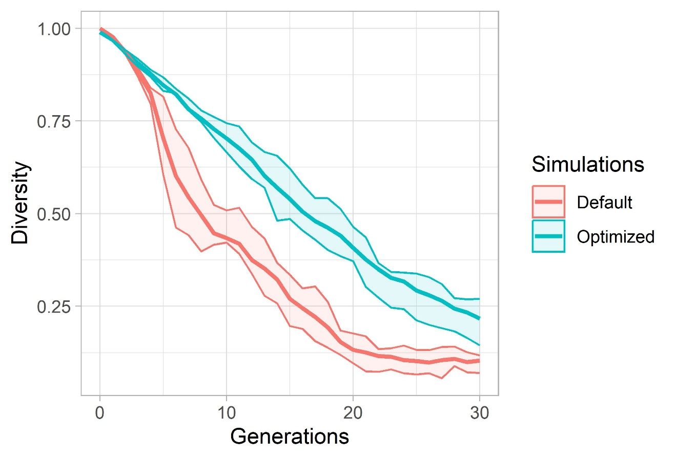
Evaluation: Start Scenario 1

Slide 16
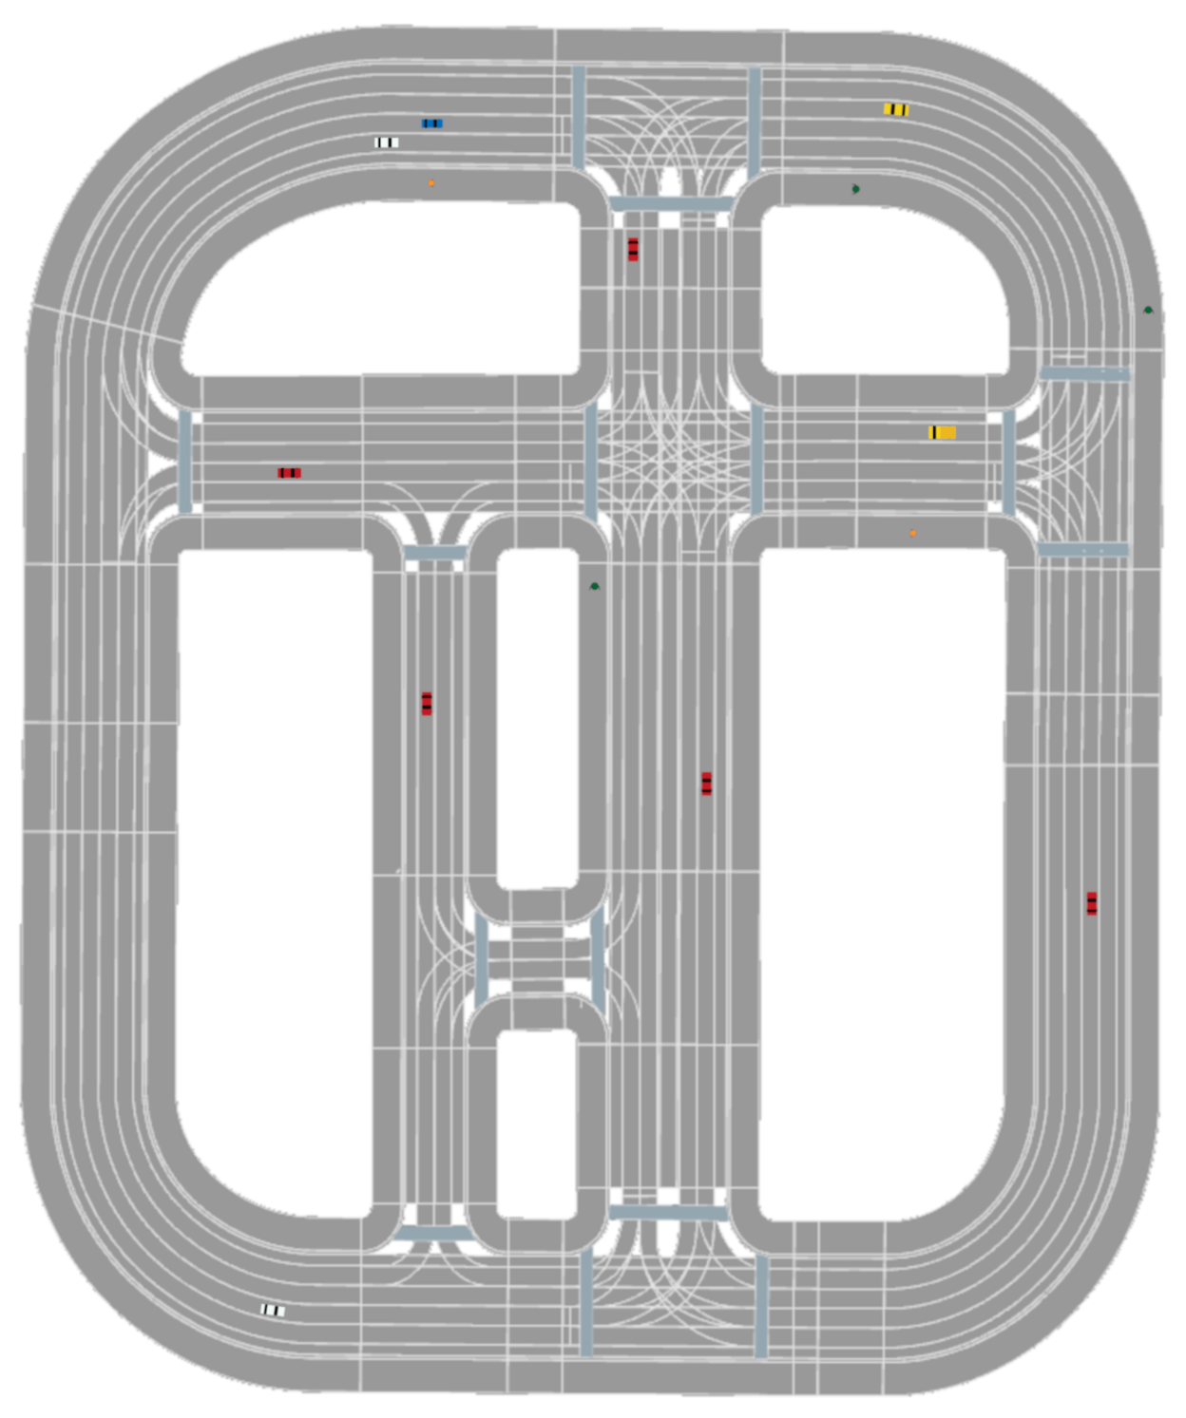
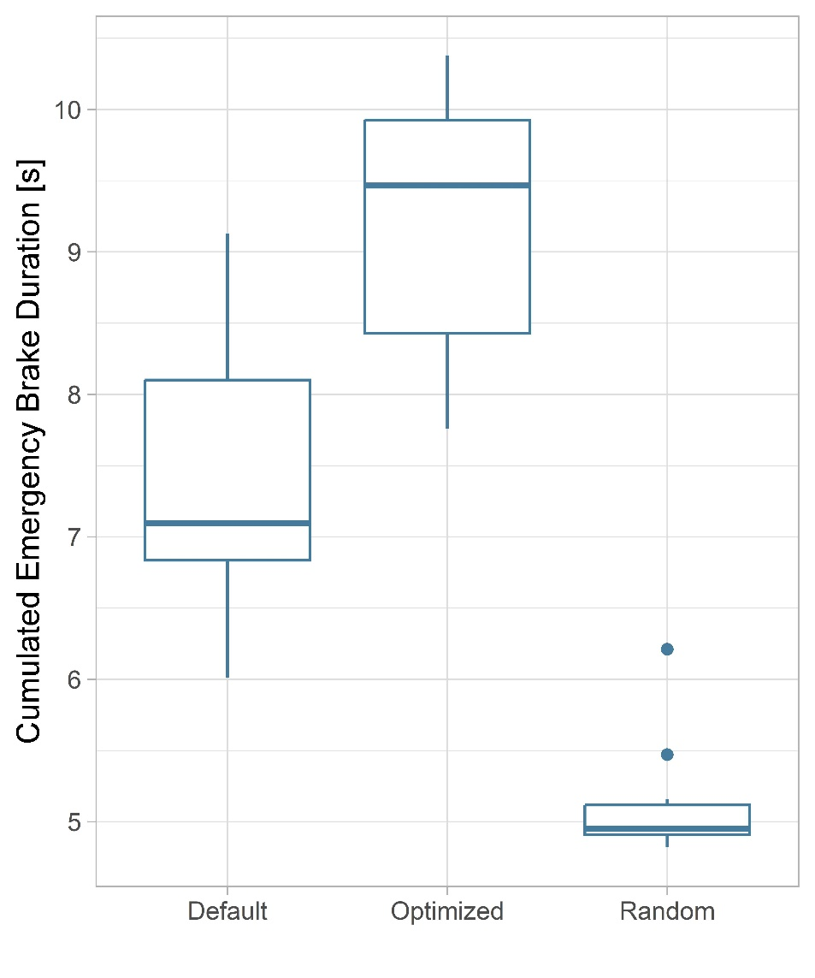
Evaluation: Start Scenario 2

Slide 17
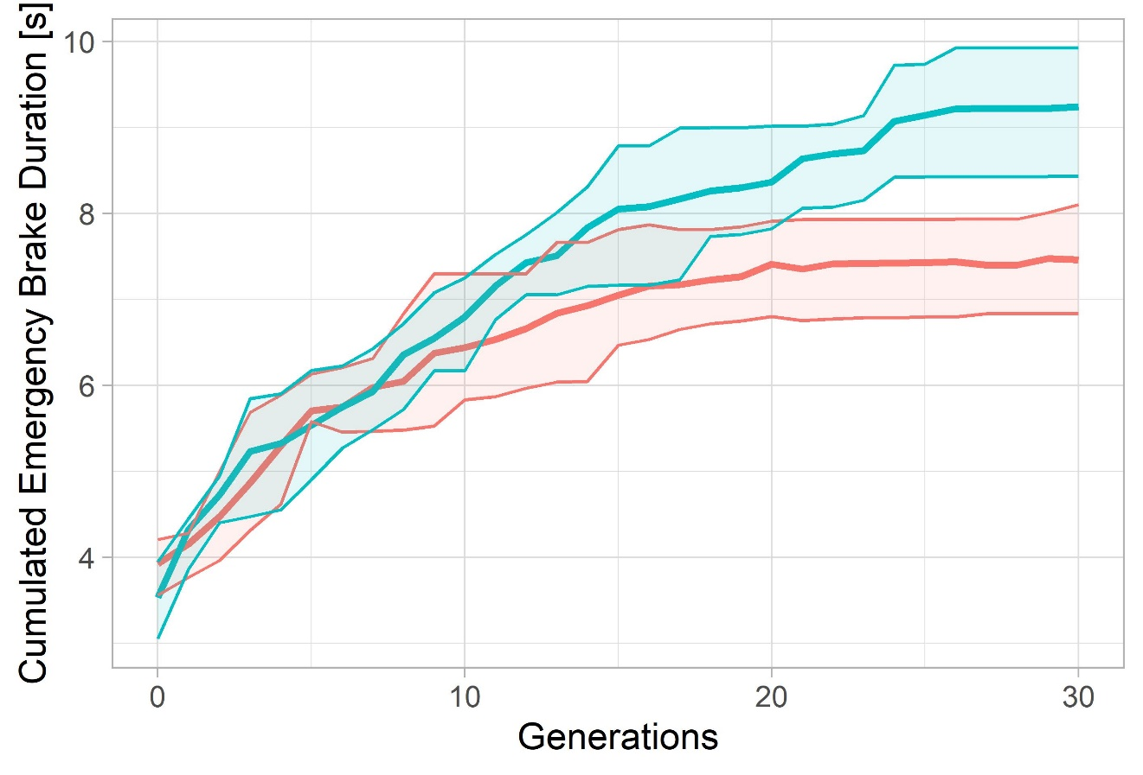
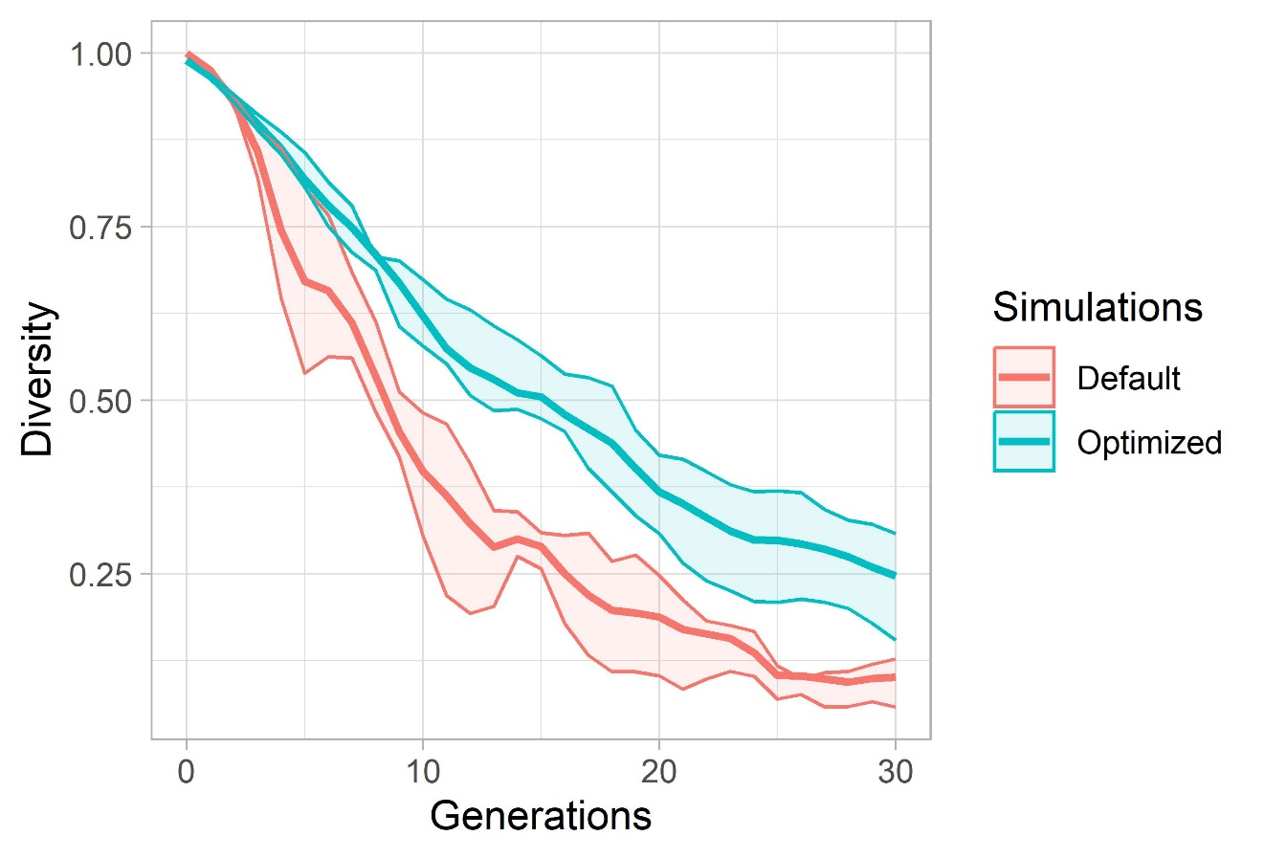
Evaluation: Start Scenario 2

Slide 18
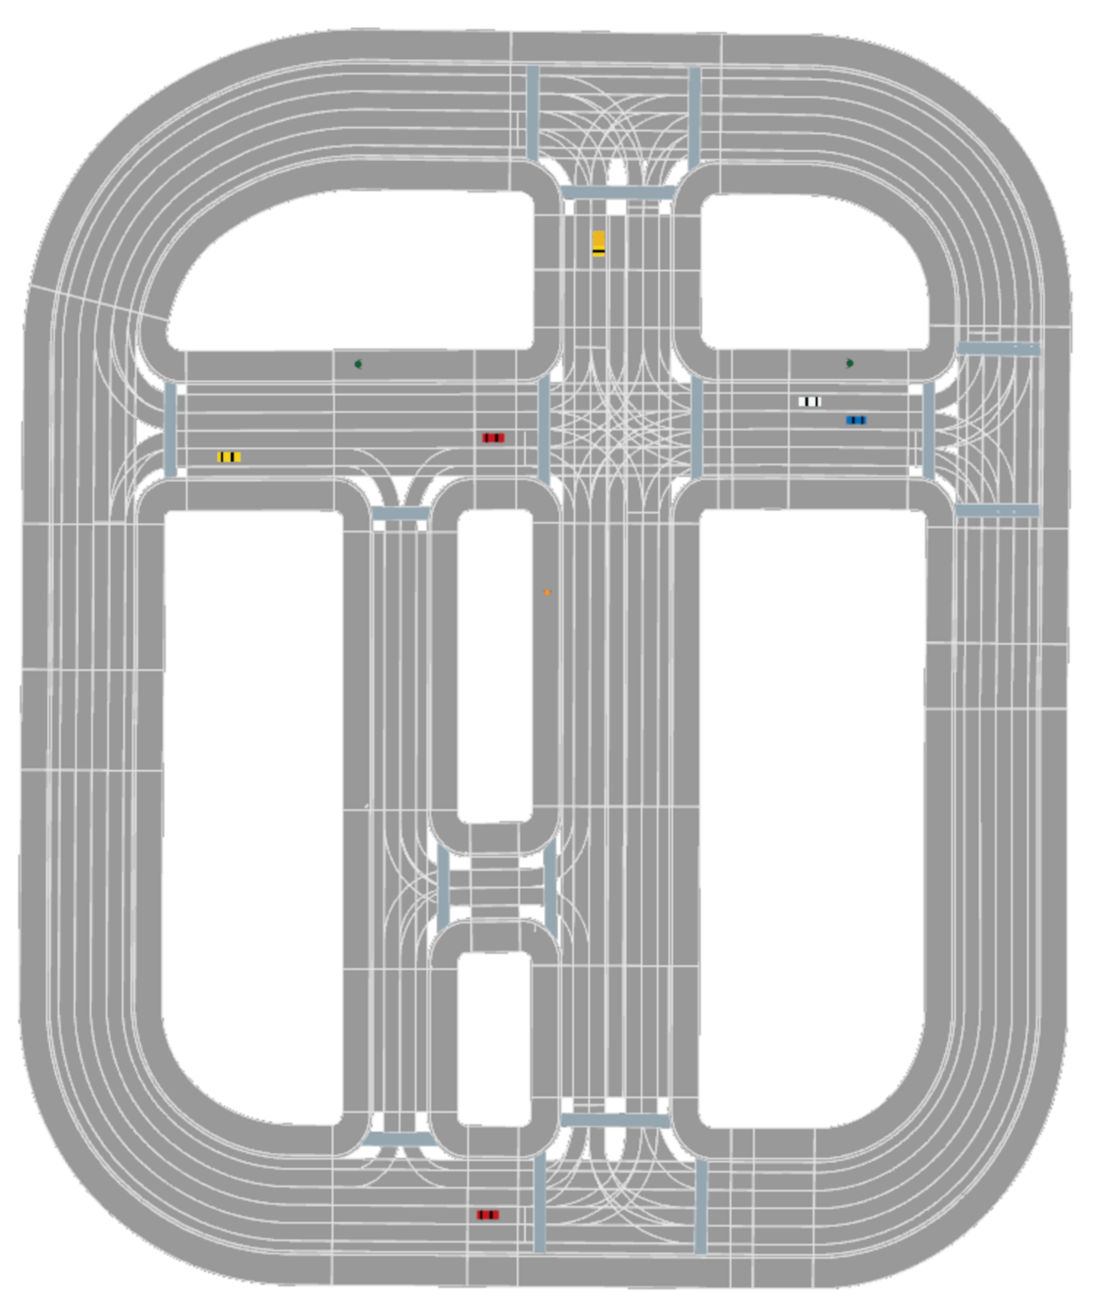
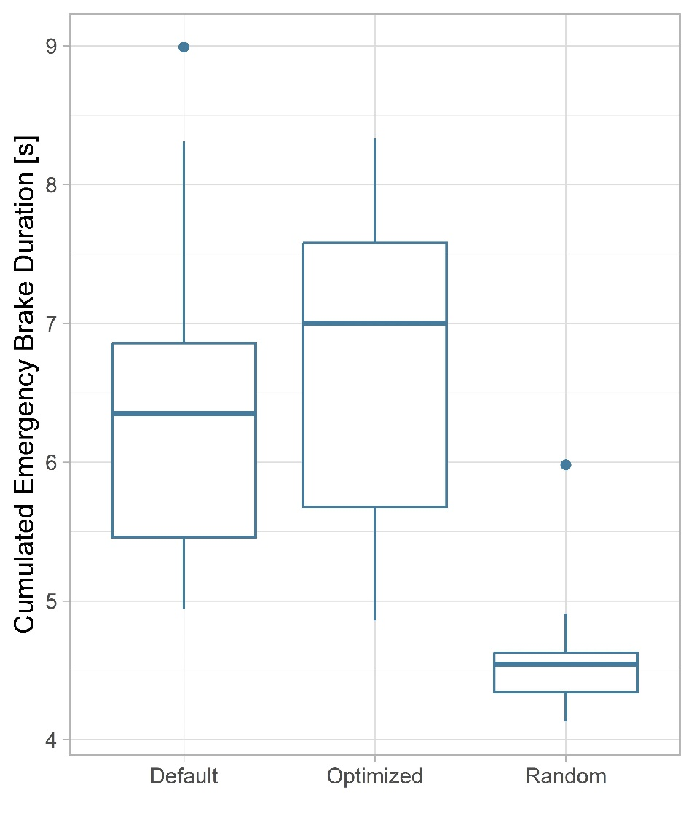
Evaluation: Start Scenario 3

Slide 19
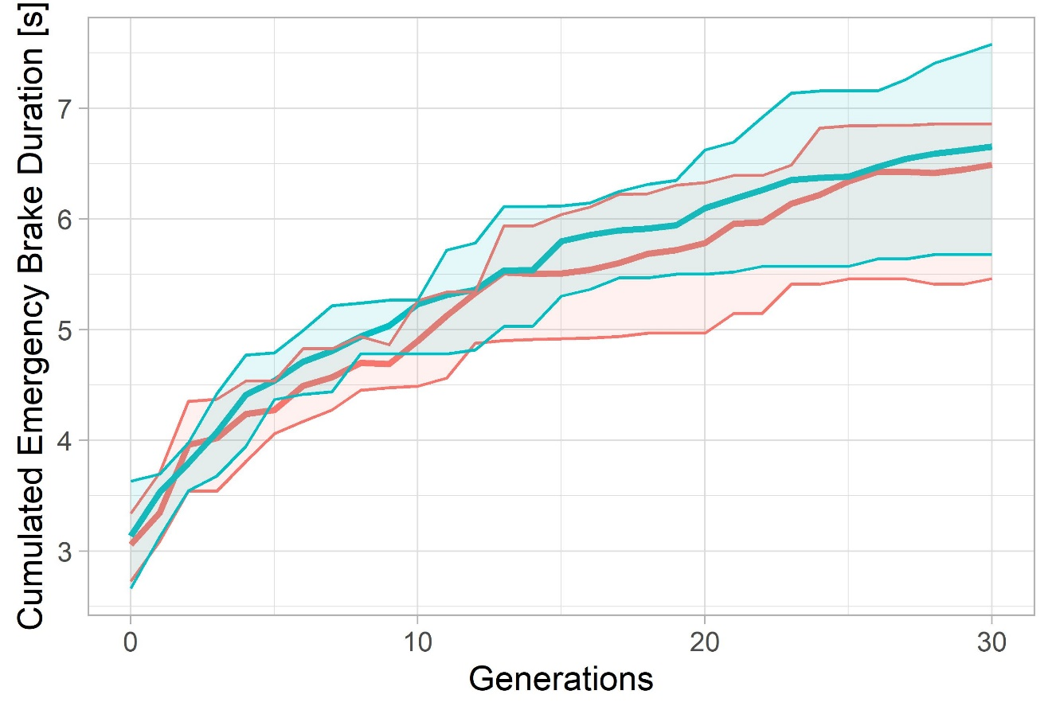
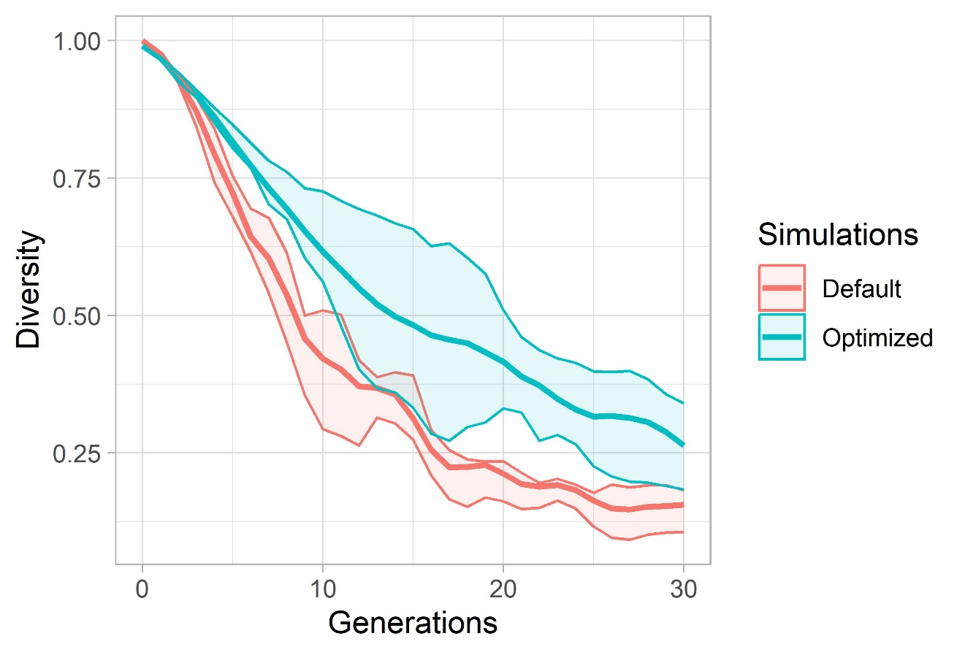
Evaluation: Start Scenario 3

Slide 20
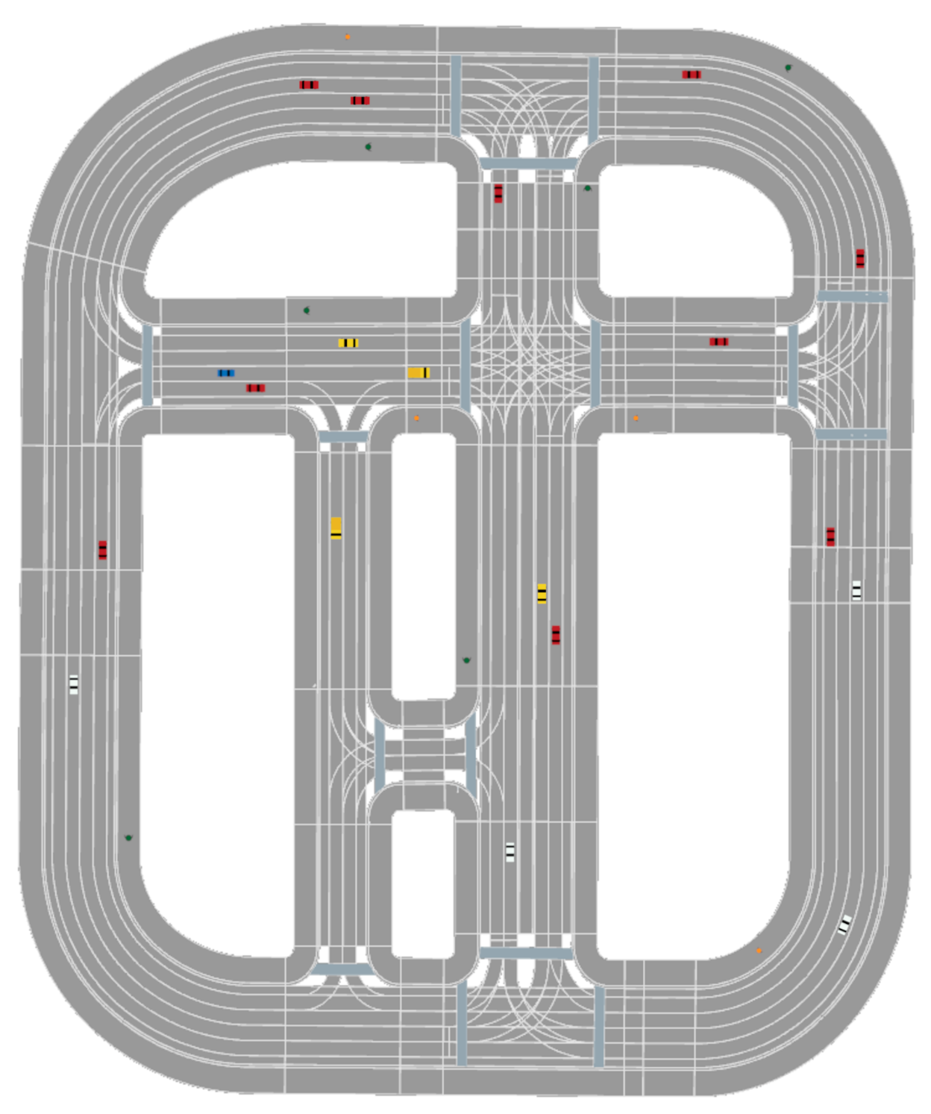
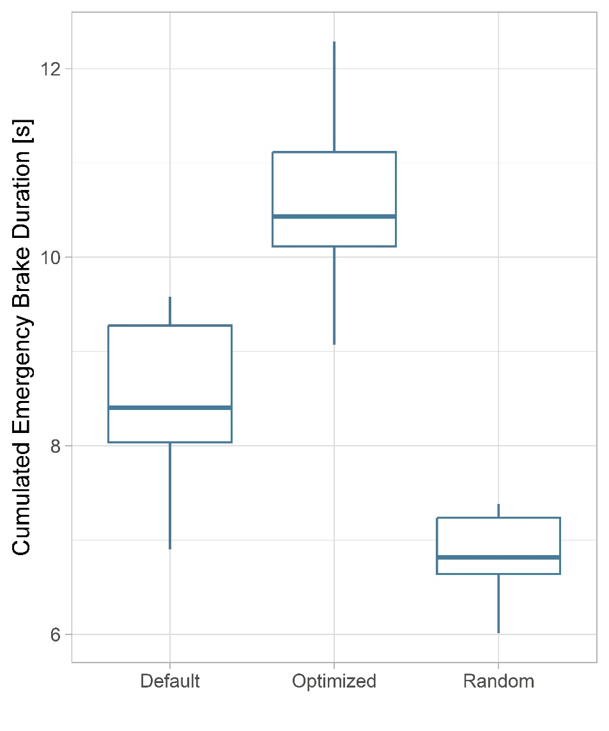
Evaluation: Start Scenario 4

Slide 21
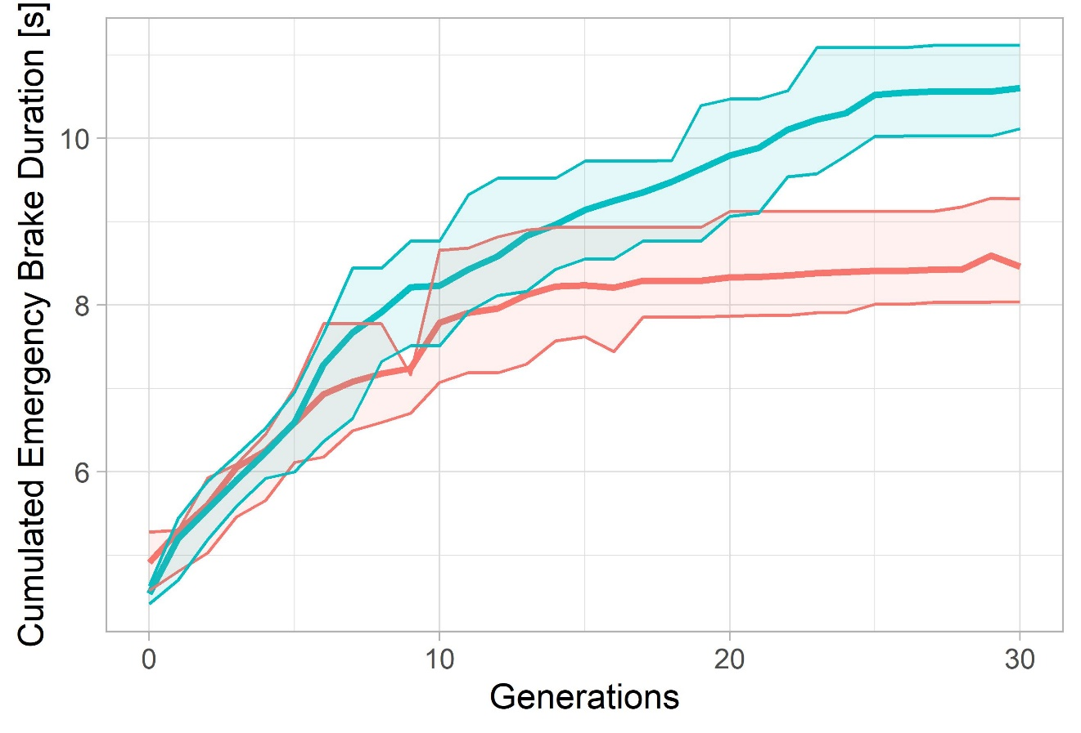
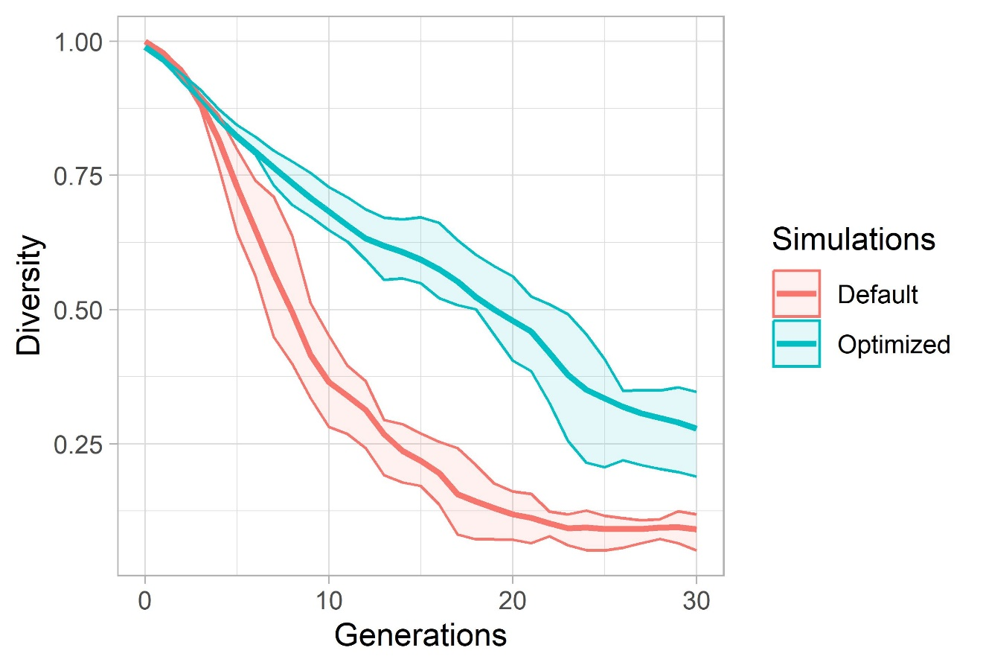
Evaluation: Start Scenario 4

Slide 22
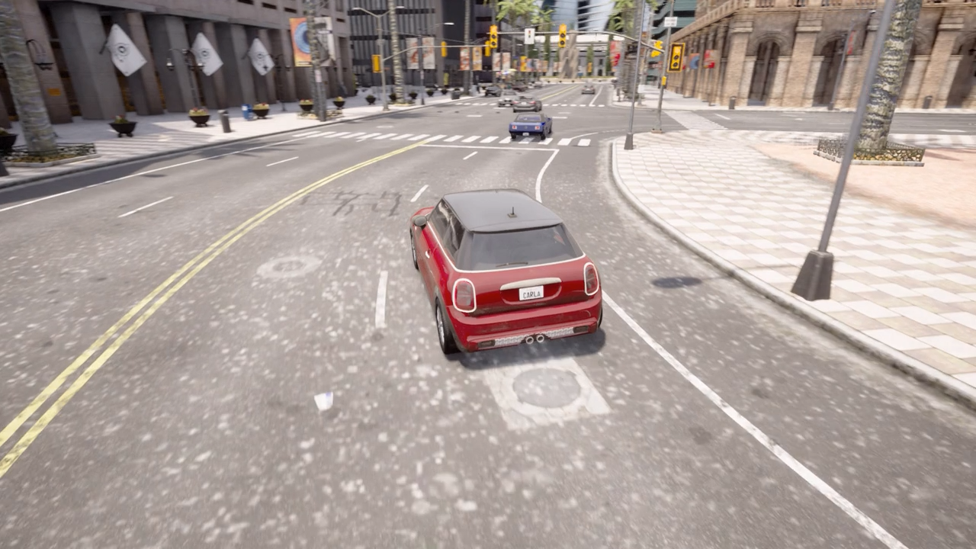
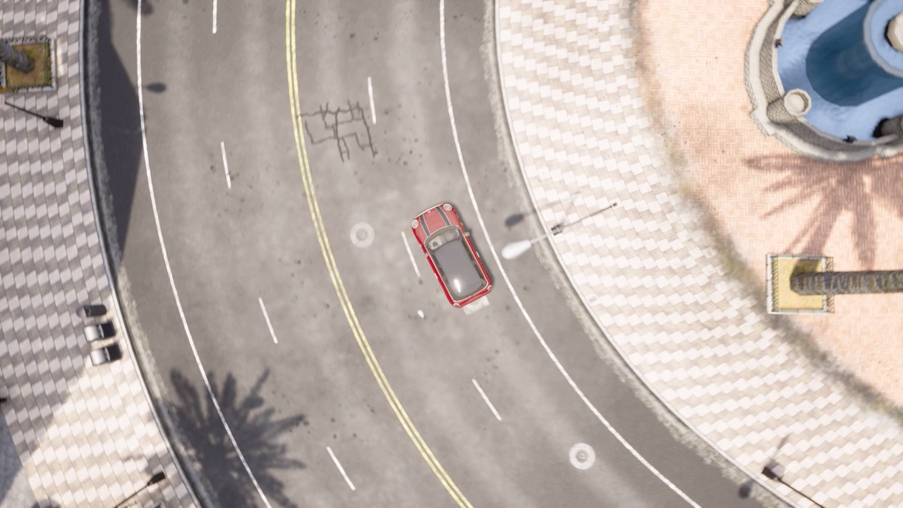
Example videos – rendered in Carla
Inside junction
NPC vehicle ignores right of way
EGO vehicle (blue) must perform emergency break to avoid crash

Slide 23
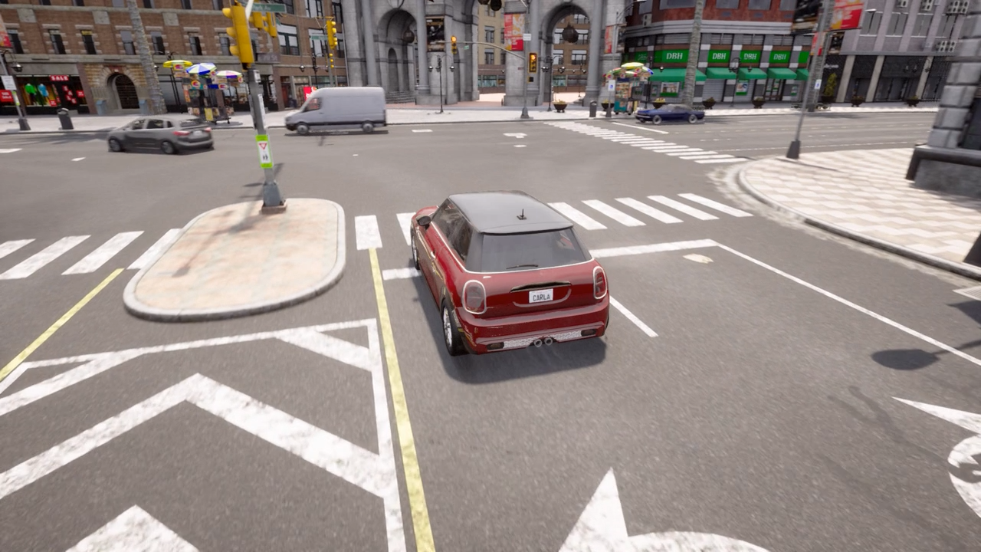
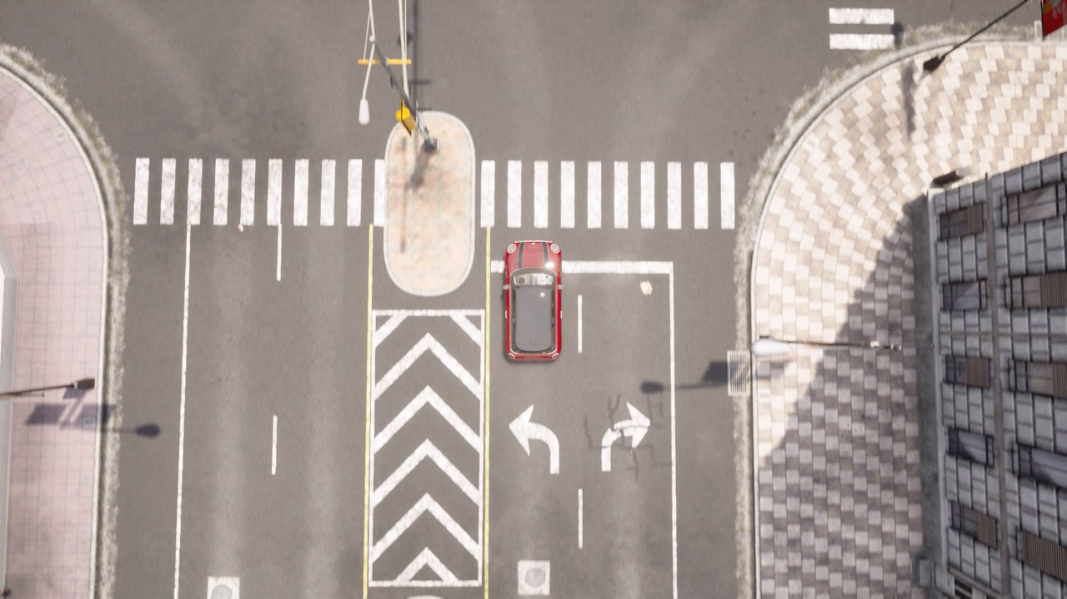
Example videos – rendered in Carla
Kid runs over road
Kid is occluded by Truck
EGO vehicle (blue) has to emergency break

